Slide 1
Postdoctoral funding programmes – FWF Erwin Schrödinger (I)
Harald Schwab & Barbara Leitner

Slide 2
Postdoctoral Funding Schemes - Agenda
Postdoc as a career
External funding organisations - overview
Most relevant national funding programmes
Erwin Schrödinger programme - overview

Slide 3
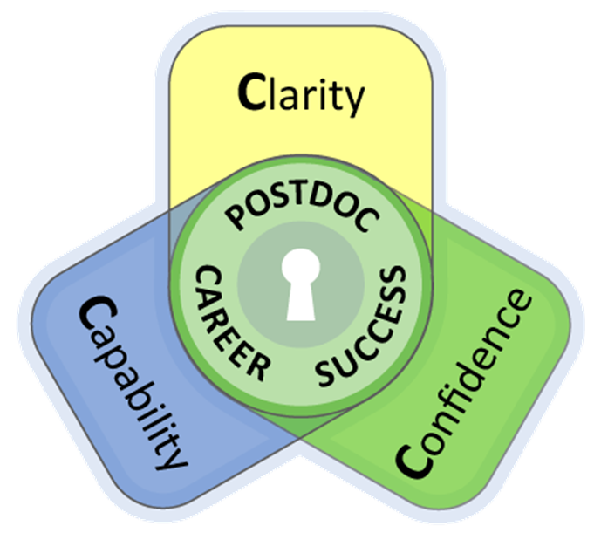
Postdoc

Slide 4
Postdoc as a career
Start preparing your postdoc-phase during your doctorate:
Dissemination (international conferences & international publications)
Professional (international) networks
Research experience abroad
Timely project development for the postdoctoral phase
Look for external funding opportunities …

Slide 5
Postdoc – employment opportunities in research/academia
In Austria:
Employment at a research institution (non-university)
Employment at an Austrian University:
PostDoc position financed by the University budget
PostDoc position financed by external funding
(lecturers)

Slide 6
Postdoc as a career
Experienced researchers:
PI in different research projects: FWF, ERC, H2020, WWTF, FFG, OeNB, Ministry, OeAD etc.
Contract research and cooperation projects with industry: FFG, CDG, H2020
professorship
group leader
With first Postdoc experience:
PI in an FWF stand-alone project
Elise Richter fellow (women only)
MSC-Actions, START-Programme (redesign!), ERC Starting Grant
publications, research experience abroad, first project experience
First Postdoc position:
As a Postdoc in a project lead by a senior researcher (FWF, WWTF, FFG, H2020 etc.)
Own fellowship programme: Erwin Schrödinger, Hertha Firnberg (women only), Max Kade, MSC- Actions etc.
International Scientific Community
first international publications (peer-reviewed)
As a doctoral candidate:
PhD position in a research project (FWF, WWTF, EU, OeNB, etc.)
Own funding (Doc-stipend, uni:docs, University funded PhD position)
Short term: KWA, Marietta Blau, open calls
Notes:
M. Kade: max. 12 Monate USA, 53.500 USD pro Jahr + travel; max. 10 years after Phd

Slide 7
External funding – most relevant national funding organisations:
FWF – Austrian Science Fund: Austria’s central funding organisation for basic research– all disciplines
WWTF – Vienna Science and Technology Fund: promotes science and research in Vienna – especially relevant for Mathematics = Mathematics and …, ICT programme
FFG – Austrian Research Promotion Agency: national funding agency for industrial research and development in Austria
ÖAW – Austrian Academy of Sciences: Austria’s central non-university research and science institution – offers different stipends and smaller funding programmes
Notes:
Doc-stipend, Max Kade …

Slide 8
External funding – most relevant international funding organisations:
HORIZON 2020/HORIZON EUROPE – the biggest EU Research and Innovation programme
National Funding schemes of other countries (e.g. DFG, SNF)
Foundations

Slide 9
National funding schemes
FWF-programmes:
prerequisite: corresponding number of publications to the applicant‘s career to date; minimum 2 publications in the five years prior to submission of the application – peer-reviewed!
Relevant programmes for early PostDocs:
Erwin Schrödinger programme (for research stays abroad)
Hertha Firnberg programme (for female postdocs only!)
Lise Meitner programme (incoming/reintegration grant)
FWF stand-alone projects (as independent applicant or project employees)
FWF Start (min. 2 years PostDoc experience, very competitive – currently under redesign)
Notes:
Publications: All the publications listed (or more than half in the case of the humanities) must have been subjected to a quality assurance procedure in line with high international standards
Meitner: incoming – researchers that have not been in Austria for the last 2 consecutive years and/or have been in Austria less than 3 years out of the last 10
Reintegration: Postdocs, that have not had their main residence in Austria for minimum 4 years prior to the application

Slide 10
National funding schemes
Erwin Schrödinger programme (1):
Outgoing fellowship for young, highly qualified post-docs of any discipline
Non-profit-oriented scientific research
Justified stay abroad (where?, why?, how long? etc.)
10 – 24 months plus return phase - optionally paid by FWF for 6 – 12 months
No deadlines; applications are accepted continuously
Approval rate 2017: ~ 35-37%
Notes:
Publications: All the publications listed (or more than half in the case of the humanities) must have been subjected to a quality assurance procedure in line with high international standards

Slide 11
National funding schemes
Erwin Schrödinger programme (2):
Completed doctoral studies
International scientific publications (corresponding to your career to date but minimum 2 international, peer-reviewed publications in the last 5 years); majority in English
Invitation from the foreign research institution (incl. waiver of overhead, bench-fees etc.)
In case of a return phase: confirmation of the Austrian research institution
Notes:
to contribute to the further development of science and the humanities in Austria and to make the resulting knowhow available and useful for science and industry in Austria.
All publications listed (or more than half in the case of the humanities) must have been subject to a quality assurance procedure in line with international standards
Majority in English (humanities = majority wider than national reach)

Slide 12
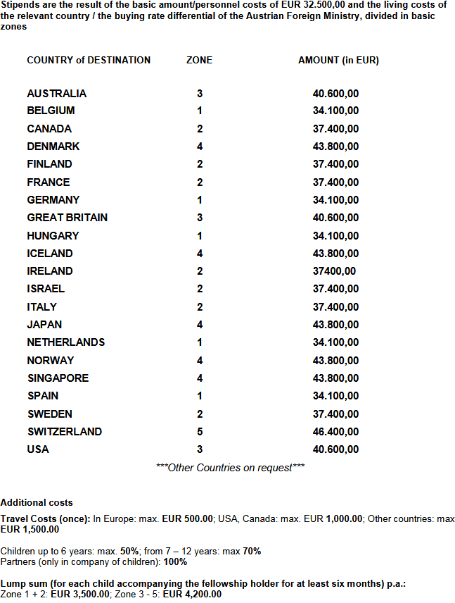
National funding schemes
Erwin Schrödinger programme (3):
Salary depending on the destination, tax free
Additional costs for travel, conference visits
Lump sums for accompanying children/partners
senior post-doc salary for the return phase 72.630 € + 12.000 € lump sum for project specific costs
Remuneration of Austrian pension insurance (voluntary)
Notes:
Publications: All the publications listed (or more than half in the case of the humanities) must have been subjected to a quality assurance procedure in line with high international standards
Senior Postdoc Salary: Brutto-Gehalt monatlich = 4.080 €
Additional money for conference visits up to 2k per year may be placed during the fellowship

Slide 13
Further information on all funding
Research Services and Career Development
Contact us!
Barbara Leitner, National Funding: b.leitner@univie.ac.at
http://forschung.univie.ac.at/en/contact/
Check our website for proposal writing workshops and information events (more to come in the winter semester): https://forschung.univie.ac.at/en/

Slide 14
Postdoctoral funding programmes – FWF Erwin Schrödinger (II)
Barbara Leitner & Harald Schwab

Slide 15
Proposal Writing

Slide 16
Funding strategy of FWF
research in Austria
Firnberg
Richter
Schrödinger
Stand Alone
START
Meitner

Slide 17
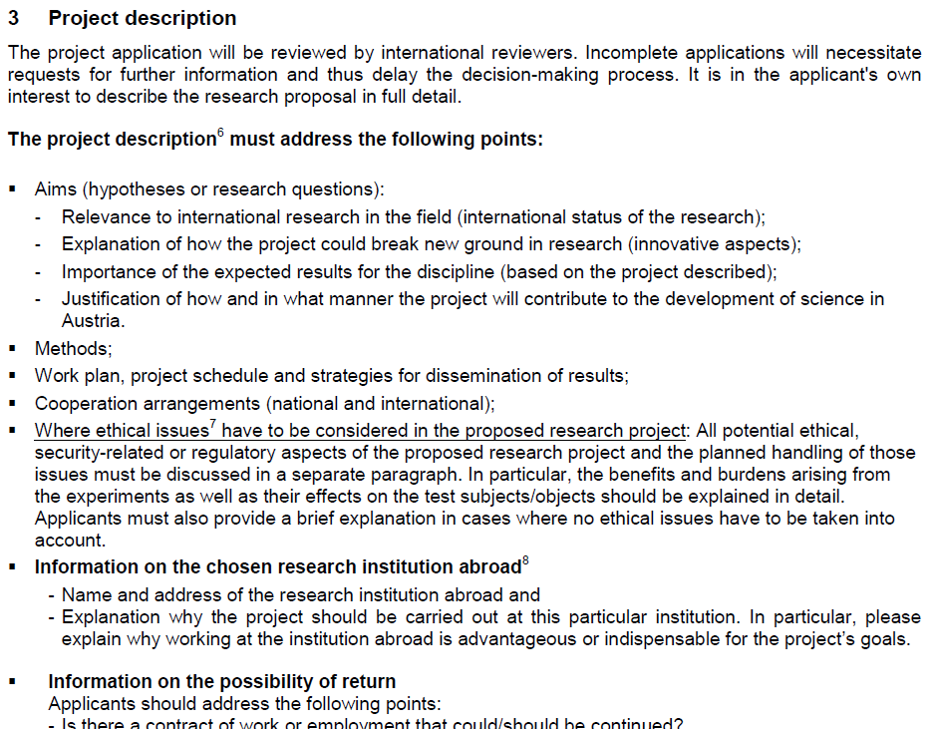
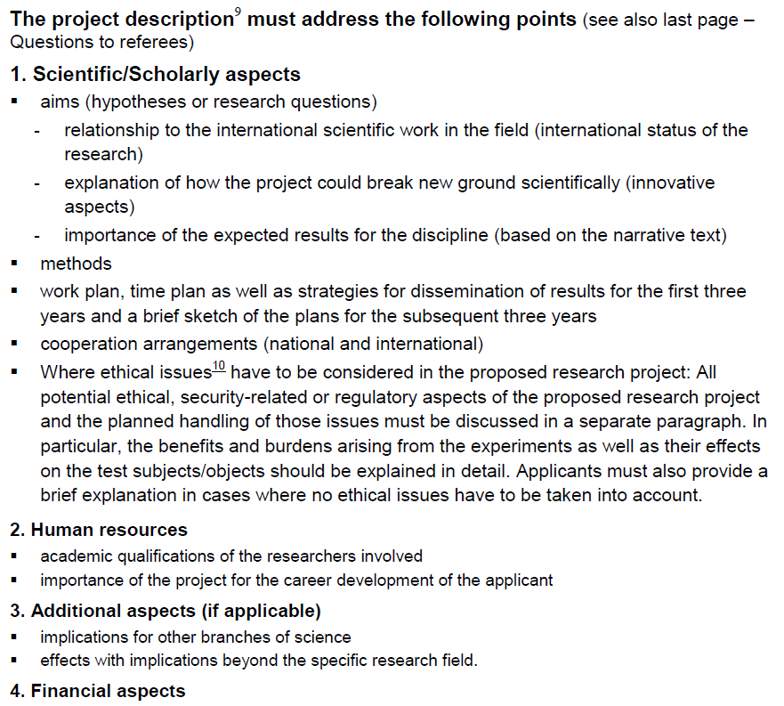
FWF - GUIDELINES
Schrödinger Programme
START Programme

Slide 18
OVERARCHING AIM
Hour Glass Model
general
Objective
Objective
Objective
specific
T
A
S
K
T
A
S
K
T
A
S
K
Research Design
specific
Outcome
Outcome
Outcome
general

Slide 19
Project description:
Aims (hypotheses, research questions)
OVERARCHING AIM
Relevance to international research
Break new ground in research
Innovative aspects
Importance of the expected results
Methods
Work plan
Dissemination
Objective
Objective
Objective
Cooperations
T
A
S
K
T
A
S
K
T
A
S
K
Work
packages
Research Design
Innovative aspects
Outcome
Outcome
Outcome
Relevance to international research
Break new ground in research

Slide 20
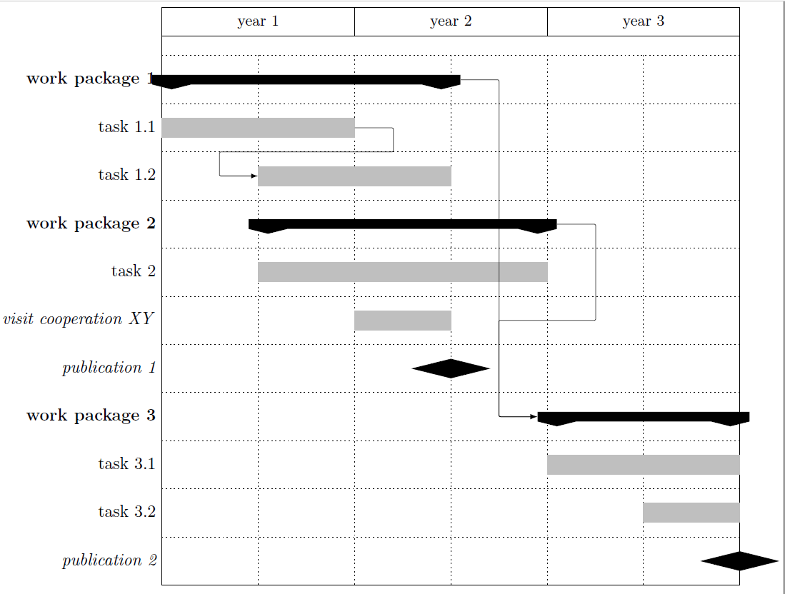
Work plan:
Gantt chart
Work package
Objective
Method
Cooperations
Outcome
Dissemination

Slide 21
Hour Glass Model
Free-form application [20 pages]
Introduction
State of the art
Hypotheses
Work package
Work package
Project description
Objectives
Methods
Cooperations
Outcome
Work plan
Dissemination
for Schrödinger programme:
Information on the chosen research institution abroad
Information on the Return Phase
Conclusion
Broader effects
Importance of the expected results
Future research, follow-up projects
Not relevant for Schrödinger programme:
Human resources
Financial aspects

Slide 22
Relevant documents:
Free form application
Bibliography
CV [with publication lists]
Academic abstract [relevant for finding reviewers]
PR abstracts [for public relations work (English, German)]
Recommendation letter [from the Austrian research institution]
additional recommendation letter [optional]
Invitation letter [from the host research institution]
Collaboration letters [optional]

Slide 23
QUESTIONS FOR REVIEWERS:
(1) Scientific/scholarly quality of the proposal
(2) Approach/methods and feasibility of the project (including return phase if applied for)
(3) Research-related qualifications of the applicant (based on her/his academic age)
(4) Appropriateness of the chosen host and the host institution
(5) Importance of the fellowship for the career development of the applicant and contribution of the know-how gained to the Austrian research landscape (objective of the funding programme)
(6) Overall evaluation with regard to key strengths and weaknesses and final funding recommendation

Slide 24
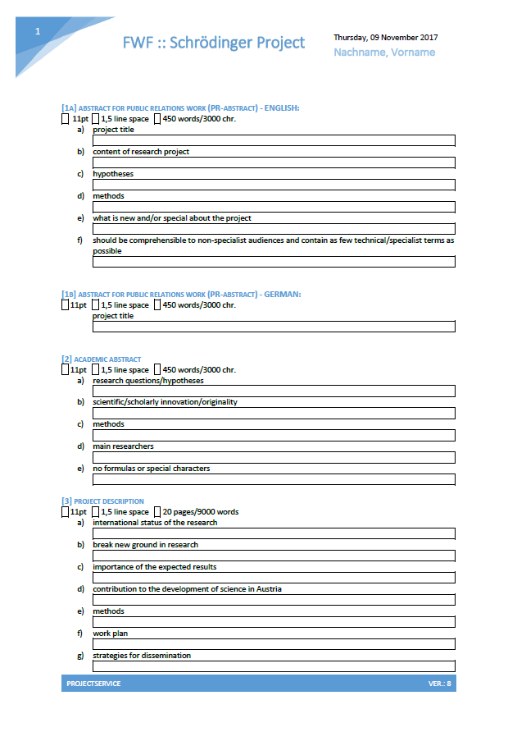
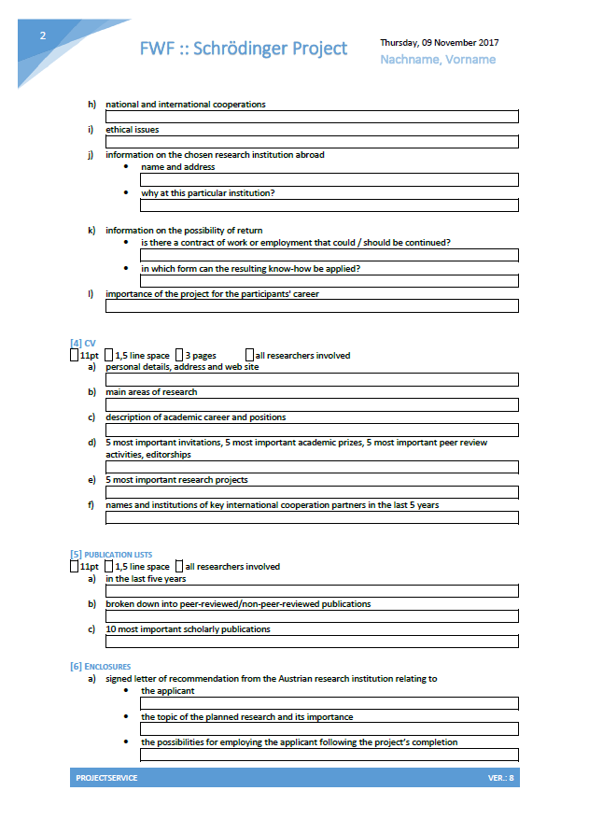
projektSERVICE – Mathematik:
We offer a detailed proposal check.
Please send an early draft version to projektSERVICE.
projektservice.mathematik@univie.ac.at http://projektservice-mathematik.univie.ac.at
office: 04.129 (OMP)

