Slide 1
The matrix
The Logical Framework Approach (LFA) as a tool for Research Support
EARMA Conference Bologna
Sascha Le Large, Anja Smykowski, Niek Bakker

Slide 2
Content
LFA-ing this session
An introduction to the LFA
A horse tale
The LFA applied – a case study
Take Home Message

Slide 3
LFA-ing this session
Research proposals i.) meet more adequately the challenges in society, ii.) are better designed, and iii.) are a better reflection of available expertise
Improving research support and strategic advice by providing a useful method
Presentation well designed to needs of audience Presentation well delivered and understood
Audience can relate presentation to own work
LFAing this session

Slide 4
An introduction to LFA
The Logical Framework Approach is a set-up / matrix that ensures the perfect fit of a project (proposal) to a call
Introduction to LFA

Slide 5
How LFA helps you:
defines the societal impact
determines a specific objective
defines outputs to reach this objective
determines concrete activities
sets success indicators to monitor progress
understands conditions and risks
Introduction to LFA

Slide 6
A horse tale
A horse tale

Slide 7
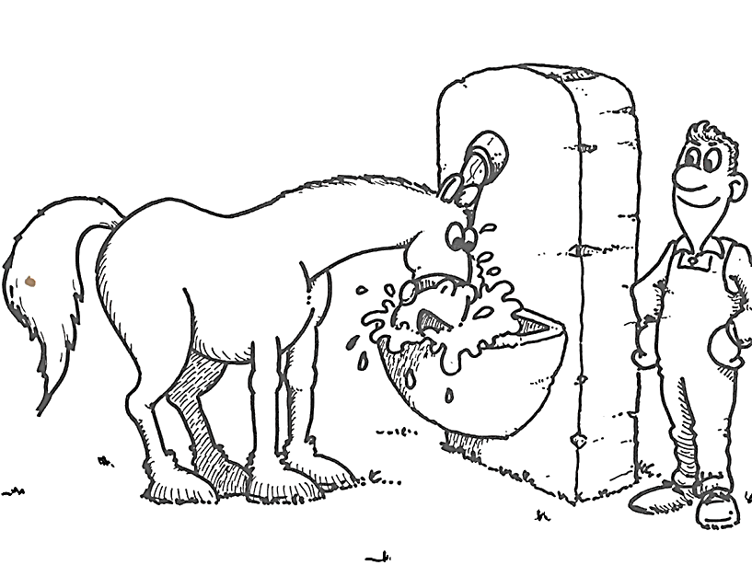
A horse tale
A horse tale

Slide 8
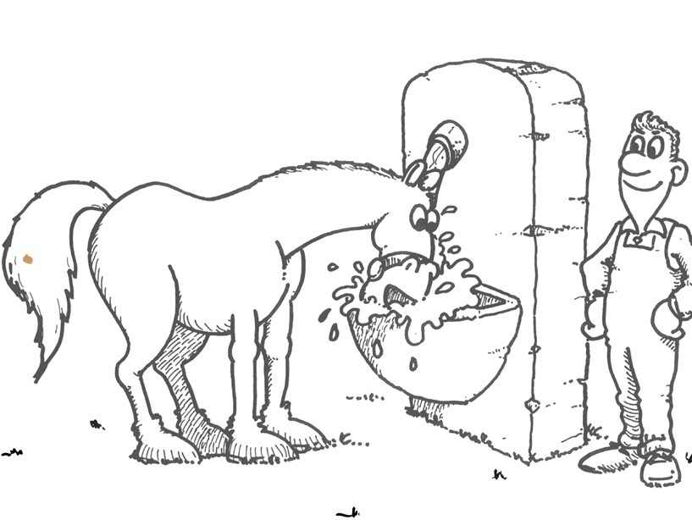
A horse tale
Challenge
Problem
Need
A horse tale

Slide 9
Intervention logic
Impact
Overall Objectives
impact
Outcome
Project Purpose
sustainability
effectiveness
Output
Results
efficiency
Input
Activities-means
Problem analysis
relevance

Slide 10
The LFA applied
The LFA applied

Slide 11
Case study: SC1-BHC-16-2018
Effectively implementing and scaling-up interventions, programmes, and policies to the regional and national levels are persistent challenges…
The LFA applied

Slide 12
Call fitted into LFA
Enhanced effective, efficient, equitable and sustainable health systems, to lesser inequalities and greater health equity and additional societal benefits, in the medium and long-term
Impact
More evidence based interventions and scale-up policies adapted to different geographical, economic and cultural settings
with regard to NCDs.
Outcome
Identification of the best evidence-based interventions
Evaluation of health outcomes
Recommendations for replication
Output
Identify, develop, test, evaluate and/or refine strategies to scale-up evidence-based practices
Include health economic assessments
Use scale-up methods, tools, and approaches to enhancing equity, efficiency, people-centered, and responsive health systems (…)
Activities

Slide 13
Scaling-up NCD Interventions in South-East Asia (SUNI-SEA)
The LFA applied

Slide 14
Call fitted into LFA
Enhanced effective, efficient, equitable and sustainable health systems, to lesser inequalities and greater health equity and additional societal benefits, in the medium and long-term
Enhance sustainable action for the achievement of the Sustainable Development Goals
Impact
More evidence based interventions and scale-up policies adapted to different geographical, economic and cultural settings
with regard to NCDs.
Validate scaling-up strategies of evidence-based diabetes and hypertension programmes
Outcome
Evidence-based scaling-up strategies
Evidence on cost-effectiveness on scaling-up
Globally applicable guidelines and instruments for scaling-up
Identification of the best evidence-based interventions
Evaluation of health outcomes
Recommendations for replication
Output
Identify, develop, test, evaluate and/or refine strategies to scale-up evidence-based practices
Include health economic assessments
Use scale-up methods, tools, and approaches to enhancing equity, efficiency, people-centered, and responsive health systems (…)
Activities

Slide 15
Take home messages
Train yourself in LFA
Professionalize research support with LFA
Improve strategic advice with LFA
Use it as a good reason to start the application process earlier
Take home messages

Slide 16
a.b.smykowski@umcg.nl
s.g.r.lelarge@umcg.nl
nb@mdf.nl

